Slide 1
Gradle Build Tool
Pavel Vrublevskij

Slide 2
Introduction
Ant -> Maven -> Gradle

Slide 3
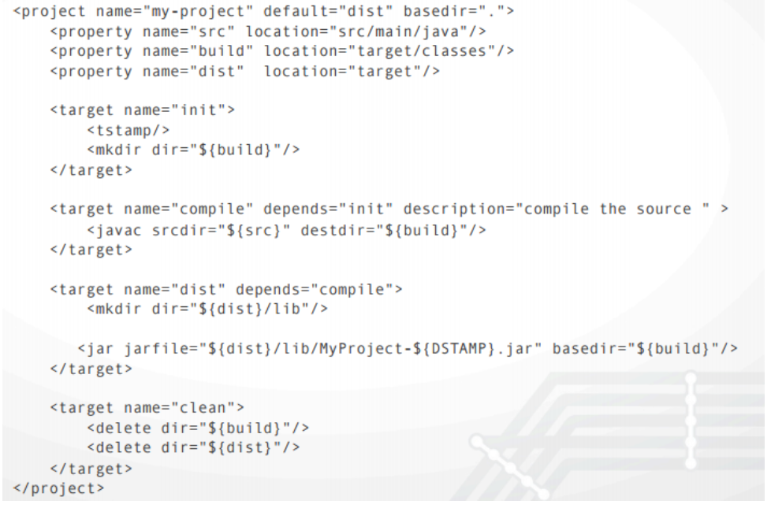
Typical Ant build.xml

Slide 4
Same in Maven
<?xml version="1.0" encoding="UTF-8"?>
<project xmlns="http://maven.apache.org/POM/4.0.0"
xmlns:xsi="http://www.w3.org/2001/XMLSchema-instance"
xsi:schemaLocation="http://maven.apache.org/POM/4.0.0
http://maven.apache.org/xsd/maven-4.0.0.xsd">
<modelVersion>4.0.0</modelVersion>
<groupId>lt.asprogramuoju.sample</groupId>
<artifactId>my-project</artifactId>
<version>1.0-SNAPSHOT</version>
</project>

Slide 5
Same in Gradle
build.gradle settings.gradle
plugins {
id 'java'
}
group = 'lt.asprogramuoju.sample'
version = '1.0-SNAPSHOT’
rootProject.name = 'my-project'

Slide 6
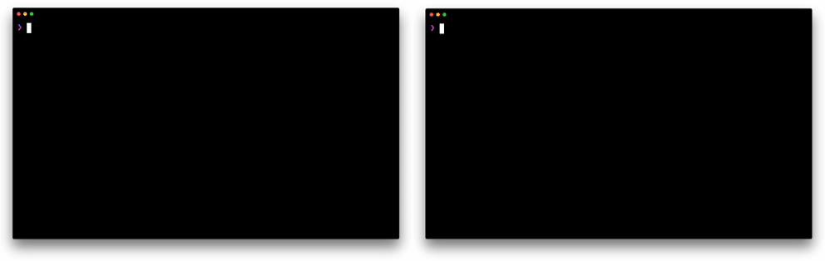
Gradle vs Maven more about difference https://gradle.org/maven-vs-gradle/

Slide 7

Introduction
Gradle is an open-source build automation tool focused on flexibility and performance. Gradle build scripts are written using a Groovy or Kotlin DSL.
Why?
Highly customizable — Gradle is modeled in a way that is customizable and extensible in the most fundamental ways.
Fast — Gradle completes tasks quickly by reusing outputs from previous executions, processing only inputs that changed, and executing tasks in parallel.
Powerful — Gradle is the official build tool for Android, and comes with support for many popular languages and technologies.

Slide 8
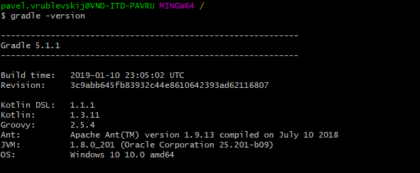
Download first
https://gradle.org
Go thru Installation guide, make for yourself
Check if all work fine:

Slide 9
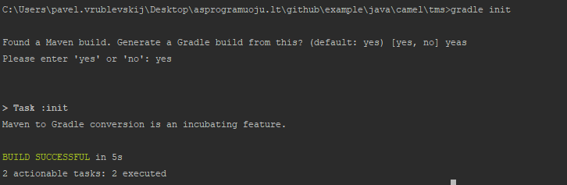
Init gradle in your existing project
gradle init

Slide 10
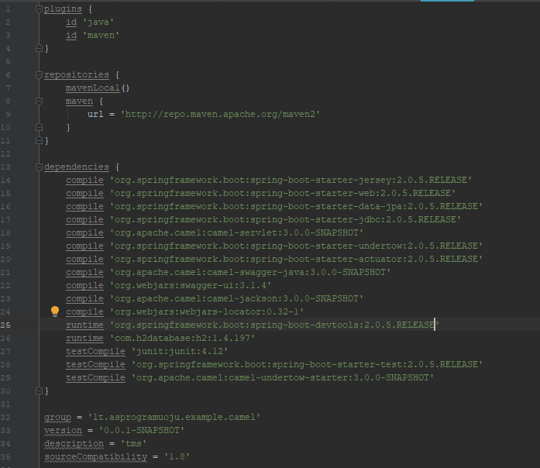
Example

Slide 11
Maven dependency to gradle
<dependencies>
<dependency>
<groupId>org.springframework.boot</groupId>
<artifactId>spring-boot-starter-jersey</artifactId>
</dependency>
...
...
Same
dependencies {
compile 'org.springframework.boot:spring-boot-starter-jersey:2.0.5.RELEASE’

Slide 12
Learn more at
https://gradle.org
Don’t forget groovy language: http://groovy-lang.org/

